Slide 1
Home Care for Older People in Urban China: Impacts of Marketisation Process
Wenjing Zhang
University of Bristol
wenjing.zhang@bristol.ac.uk

Slide 2
Outline
Aims
Background
Theoretical framework
Methods
Findings

Slide 3
Aims
To explore impacts of marketisation of home care in urban China
Rationale behind the marketisation of care
Marketisation trend of home care
Processes of marketisation of home care

Slide 4
Background
Care policy and provision for older people in China
Home care in China
Rural vs urban disparities

Slide 5
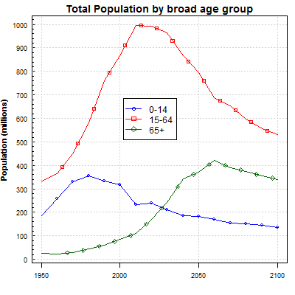
Care policy and provision for older people in China
Dramatic demographic changes
rapid ageing (65+, 10.1%, 2014)
‘one child policy’ – decreasing household size from 4.43 in 1964 to 3.02 in 2014
Social-economic reforms
e.g. labour market, housing marketisation, migration
Increasing old-age dependency challenges the family-centred care provision
Source: United Nations, Department of Economic and Social Affairs, Population Division (2015).

Slide 6
Home care
Home care is the foundation of the Chinese elder care system, combining community care and residential care (Ministry of Civil Affairs in China, 2010)
e.g. ‘9064’ in Beijing; 9073’ in Shanghai; ‘9055’ in Wuhan
Definition: services provided at older people’s homes by care workers or a mix of care workers and family members
personal care (e.g. nursing), practical care (e.g. cooking, shopping, cleaning), emotional support

Slide 7
Different care systems in urban and rural China
Different ageing paths and ‘double-track elder care system’
Over 20% aged 60 and older in cities like Beijing, Shanghai, Suzhou (national 14.9%, 2014).
Fewer adult children due to the stricter ‘one child policy’ in urban China (Zhan, 2013).
Urban residents have more access to resources from the state and market
Extensive marketisation in urban China since 1990s
e.g. housing, education, welfare.
Development of home care in urban areas is more rapid than in rural China

Slide 8
Theoretical framework: marketisation of care
Definition: the application of markets, market principles, and market mechanisms in the field of social care
Embedded convergences at international level
Different paths/characteristics

Slide 9
Qualitative approach
Home care market
purchaser
provider
user/ carer
Service providers & local regulators
(purchasers)
Fieldwork
Shanghai
forefront of marketisation
Stakeholders
service users, providers, purchasers,
care workers, regulators.
30 Interviews
21 care agency managers; 9 public officials
Policy documents

Slide 10
Context of Shanghai in China, 2014
 | China | Shanghai
Ageing population (65+) | 137,550,000 10.1% | 2,566,300 17.9%
GDP per capita | RMB 47,203 (£4,720) | RMB 97,370 (£9,737)
Marketisation level¹ | 6.56 | 9.78 (Rank 2 of 31 provinces)
Urbanization rate | 56% | 90%
Note: 1. Marketisation level is measured by indicators of the relationship between the state and the market, non-state-owned economy, factor market, product market, and market intermediaries and legal environment (Fan, et al., 2015).
Source: National Bureau of Statistics of China, National Economic Research Institute, China Reform Foundation; Shanghai Research Centre of Ageing

Slide 11
Sampling criteria
Categories | Sub-categories | Groups | Number
Service providers | Managers | Higher managers in charge of agencies | 8
 |  | Managers in service sector | 9
 |  | Managers in marketing sector | 3
 | Staff in local stations | Care manager and care worker | 2
Public officials / local administrative in the field of care for older people | Public officials in sub-district (jiedao) level |  | 5
 | Public officials in community (shequ/juwei) level |  | 4

Slide 13
Findings
Home care: based on persistent culture value of filial piety
Shifting balance of care diamond in urban China
Quasi-market in urban China

Slide 14
Home care: based on persistent culture value of filial piety
Cultural norms
Family
Preference of older people and their family
Objective constraints
Familial care cannot cover
Institutional/community care are not enough

Slide 15
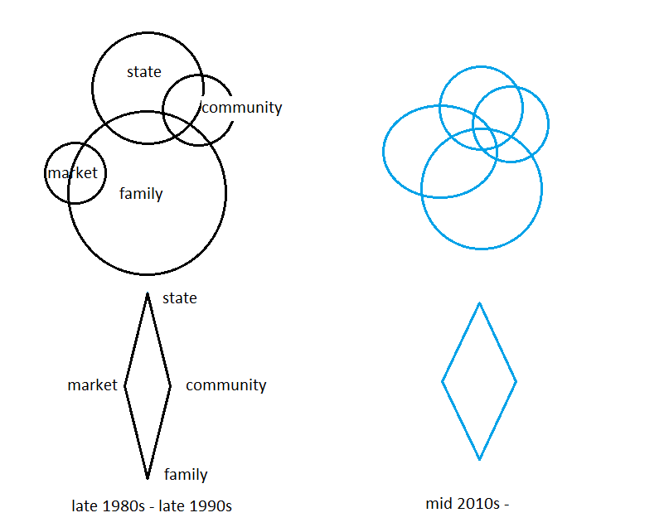
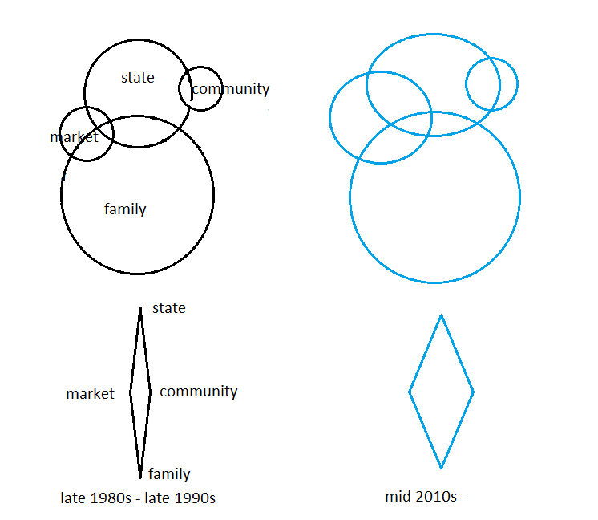
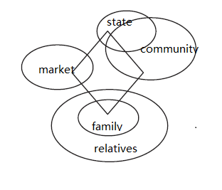
Care diamond
Service
Shifting balance of state, market, family and community in the field of care for older people
Financing
Regulation
Mixed economy of care
Service provision for older people in urban China
Financing for older people in urban China
Elder care diamond in China
Source: Ochiai (2009)

Slide 16
Quasi-market in urban China
Quasi-market (Le Grand, 1991)
Market: competitive independent agencies replacing the monopolistic state providers
Differences to conventional markets:
not-for-profit and/or for-profit organisations competing for public contracts
vouchers involved for purchasing
the consumers represented in the market by agents

Slide 17
Processes of marketization of care in urban China
Contracting out
Service provision programs, care agencies
Financial support from the state
e.g. subsidy programs to older people, care workers.
from directly allocated to providers to purchasing through a bidding process
Direct purchasing through private funding

Slide 18
Prospects of quasi-market in urban China
Market: care demands are not fully expressed, seize market share
In theory: disable prevalence ratio of 65+, 80+.
In practice
consumption attitudes of Chinese people (older generation)
purchasing power of older generation
State
‘Paternal’ responsibilities
persistent financial & policy support, guiding service consumption, regulating
Debates: protecting ‘vulnerable’ VS marketisation

Slide 19
Thank you!
wenjing.zhang@bristol.ac.uk

