Slide 1
The Ideal Working Situation for Residential Social Workers at Intensive Care Homes
Masakazu Shirasawa, Ph.D.^{１）}
Hiroshi Ishida^{2）}
1）Graduate School of gerontology, J. F. Oberlin University, Japan
2)Hiroshima ken Saiseikai Social Welfare Center, Japan
Notes:
I'd like to thank you for the opportunity to give this presentation today. At first, let me introduce myself. My name is Masakazu Shirasawa, professor of Graduate School of Gerontology, J. F. Oberlin University in Japan. Although my major of studying is case management and long-term care policy, today’s presentation is focused on residential social workers of intensive care home.

Slide 2
Today’s subject of my presentation
Although in Japan, intensive care homes have duty to employ residential social workers as professional staffs, their functions are vague and they are mocked as “Jacks of all trades.”
In my presentation, I try to clarify primary scope of work from the point of view of residential social workers themselves.
Notes:
Although in Japan, intensive care homes have duty to employ residential social workers as professional staffs, their functions are vague and they are mocked as “Jacks of all trades.”
In my presentation, I try to clarify primary scope of work from the point of view of residential social workers themselves. The Ideal Working Situation for Residential Social Workers at Intensive Care Homes based on evidences clarified from our research focused to residential social workers.

Slide 3
Table １: Differences between first and second insured persons
 | first insured persons | second insured persons
age | 40～65 | 65 and over
Numbers of the insured | 29 million 780 thousand | 42 million 990 thousand
Eligibility of services | Needed to Long-term care or support | Added needs of care or support to by disease caused aging
Numbers and % of accreditation | 5 million 150 thousand (17.2%) | 160 thousand (0.4%)
Collection methods of premium | Deduct from pension | In a lump with premium of Medical insurance
March, 30, 2013
Notes:
Do you have 2 sheets of document which I distributed?
Hear, I'd like to talk about Japanese long-term care insurance system established in April 2000. briefly.
In the framework of the long-term care insurance system, the governments of municipalities become insurers. As shown in table 1, there are first insured persons aged 65 years or over and second insured persons who are medical insurance members aged between 40 and 64. Between those two types of insured, there are differences in eligibility of services and collection methods of premium.

Slide 4
The insured is accredited
The insured is accredited as being in need of long-term care or support by the municipality.
Certified persons are categorized into seven stages which consist of two stages of those requiring support and five stages of those requiring long-term care.
A person requiring long-term care is defined as a person who is expected to be in need of constant long-term care, in all or partial basic motions in daily life such as having meals, bathing and excretion due to physical or mental disability.
A person requiring support is defined as a person who is expected to constantly experience impediments in daily life due to physical or mental disability.
Notes:
When the insured is accredited as being in need of long-term care or support by the municipality, the said person is able to receive the long-term care service according to the level of needed care.
Certified persons are categorized into seven stages which consist of two stages of those requiring support and five stages of those requiring long-term care. Available services vary among persons requiring support or long-term care, and the service for persons requiring support is intended to prevent, to the greatest degree possible, becoming in need of long-term care.
A person requiring long-term care is defined as a person who is expected to be in need of constant long-term care, in all or partial basic motions in daily life such as having meals, bathing and excretion due to physical or mental disability.
A person requiring support is defined as a person who is expected to constantly experience impediments in daily life due to physical or mental disability.

Slide 5
services are available for persons requiring long-term care.
The long-term care insurance system in Japan covers 21 at-home medical/nursing care services and 3 nursing care home services.
Nursing care homes
(1)include intensive care homes are known as a special nursing homes for the elderly, provide services to persons who require constant long-term care, but cannot be cared for at home.
(2)health institutes for long-term care of the elderly provide nursing, long-term care and functional training with the aim of returning home.
(3)long-term health care facilities for the elderly manage treatment and provide nursing, long-term care and functional training with the aim of engaging in daily life according to capacity. A plan to abolish the last type of facility is on hold due to a concern over securing new homes for its residents.
Notes:
The long-term care insurance system in Japan covers 21 at-home medical/nursing care services and three types of long-term care facilities for the elderly. They are (1) “include intensive care homes”, (2) “health institutes for long-term care of the elderly” and (3) “long-term health care facilities”.
(1) intensive care homes are known as a special nursing homes for the elderly, provide services to persons who require constant long-term care, but cannot be cared for at home.
(2) health institutes for long-term care of the elderly provide nursing, long-term care and functional training with the aim of returning home.
(3) long-term health care facilities for the elderly manage treatment and provide nursing, long-term care and functional training with the aim of engaging in daily life according to capacity. A plan to abolish the last type of facility is on hold due to a concern over securing new homes for its residents.

Slide 6
About Intensive care homes
Intensive care homes are 8,000 homes accommodating 520,000 residents, of which nearly 80% have dementia and 70% require intensive nursing care level, and supporting those who cannot live independently at home.
Intensive care home employees include care workers, nurses, residential social workers and et.al as professional staffs.
For example, an intensive care home admitted 50 persons need to arrange 15 and over care workers, 2 and over nurses, one residential social worker, one doctor who are full-time employment or pert-time employment, one nutritionist, and one care manager who work full-time or doubled with other job.
Notes:
The most commonly used facilities are the intensive care homes and todays I focused on intensive care homes at my presentation. There are 8,000 such homes accommodating 520,000 residents, of which nearly 80% have dementia and 70% require intensive nursing care level, and supporting those who cannot live independently at home. Last year we changed to limit the admission eligibility from five stages of those requiring long-term care too upper 3 stages of those requiring long-term care.
Intensive care home employees include care workers, nurses, residential social workers and et.al as professional staffs. For example, an intensive care home admitted 50 persons need to arrange 15 and over care workers, 2 and over nurses, one residential social worker, one doctor who are full-time employment or pert-time employment, one nutritionist, and one care manager who work full-time or doubled with other job.

Slide 7
Figure 1: Changes in breakdown of the service users (comparison between FY2000 and FY2013)
(ten thousand)
residents of long-term care insurance facilities
3.94 times
home service users
home service users
Notes:
As shown in Figure 1, in FY2013 a monthly average number of home service users totaled 471 million and residents of long-term care insurance facilities totaled 890 thousand. The facility residents accounted for as high as 34.9% of the total service users in FY2000, but decreased significantly to less than 20% as of today.
This is also evident in financial resources for long-term care insurance, where facility services accounted for 34.9% in the start year in FY2000, but significantly decreased to 18.9% in FY2013, a decline from one thirds to almost one fifths.
It implies a growing preference to home care focusing on the long-term care insurance system. On the other hand, the fact that there are many who are requesting to be admitted to a welfare institute for long-term care of the elderly, but are on the waiting list, has become an issue.
Compared with in-home service, increase of intensive care homes is slow increased, because Japanese long-term care insurance policy is directed supported the frail elderly in their homes.

Slide 8
Aims of this study
This presentation, I focused residential social workers at intensive care home. Though mocked as “Jacks of all trades,” residential social workers conduct a variety of tasks.
This study is to summarize the tasks residential social workers perform and their ideal tasks, and to propose what their ideal tasks should be from the perspective of residential social workers themselves.
Notes:
This presentation, I focused residential social workers at intensive care home. Though mocked as “Jacks of all trades,” residential social workers conduct a variety of tasks.
This study is to summarize the tasks residential social workers perform and their ideal tasks, and to propose what their ideal tasks should be.

Slide 9
Methods of this study
Questionnaire surveys were posted to 400 residential social workers on March 2014 and 107 valid responses were obtained.
We asked residential social workers about both their ideal tasks and the tasks that they actually carried out.
They were asked 41 questions derived from the results of a previous study, and answers were graded on a five-point scale.
.
Notes:
Questionnaire surveys were posted to 400 residential social workers on March 2014 and 107 valid responses were obtained. We asked residential social workers about both their ideal tasks and the tasks that they actually carried out. They were asked 41 questions derived from the results of a previous study, and answers were graded on a five-point scale.

Slide 10
Table 2 Basic attributes of the responders
Gender
Male 62 （57.9）
Female 45（42.1）
Aged
40 and under 60（56.1）
40 and upper 47（43.9）
Double as care managers or not
Yes 27（25.2）
No 80（74.8）
Years of experience as residential social worker
5 years and under 34 （31.8）
5 years and over 70 （65.4）
Academic background
junior college graduate and lower 53 （49.5）
university and over 54 （50.5）
Notes:
As the results, Basic attributes of response residential social workers are indicated at Table 2. Of total response social workers are 107.
About percentage of gender, male is 57.9 % and female is 42.1 %.
About percentage of aged, 40 and under is 56.1% and 40 and over is 43.9%.
About percentage of doubled as care managers or not, full-time residential social workers are 74.8% and doubled as care manager is 25.2%.
About years of experience as residential social worker, 5 years and under is 31.8% and 5 years and over is 65.4%.
About academic background of residential social workers, junior college graduate and under is 49.5% and university graduate and over is 50.5%.
That is the basic attributes of response residential social workers of Intensive Care Homes.

Slide 11
Figure 2 Results of Factor Analysis
actual scope of work
ideal scope of work
admission support
operation management
life consultation related
rights advocacy
operation management
admission support
Making care plan by
assessment
care plan making
welfare education
center related
everyday life support
welfare education
center related
everyday life support
coordination with
external organizations
assessment
coordination with
External organizations
securing valuables
Notes:
Next, we analyzed both actual and ideal residential social worker’s scope of work using factor analysis. You can understand the results by 2 sheets of documents.
Table 1 of documents or Figure 2 of slide indicate results of factor analysis by varimax rotation of 41 items yielded eight factors for the residential social workers’ actual scope of work:
(1) admission support,
(2) life consultation related,
(3) operation management,
(4) making care plan by assessment,
(5) everyday life support,
(6) welfare education center related,
(7) coordination with external organizations, and
(8) securing valuables
And Table 2 of documents and figure 2 of power point for the ideal scope of work, the factor analysis yielded the following eight factors:
(1) operation management,
(2) rights advocacy,
(3) admission support,
(4) care plan making,
(5) welfare education center related,
(6) everyday life support,
(7) assessment, and
(8) coordination with external organizations.

Slide 12
Results of factor analyses
As the results, similarity and difference of factors actual and ideal residential social worker’s scope of work are clarified. Similarity factors of actual and ideal residential social worker’s scope of work are admission support, and everyday life support for residences, operation management of facility, coordination with external organizations, and welfare education center related persons.
Difference of factors actual and ideal residential social worker’s scope of work is that ideal scope of work has rights advocacy for residences and actual scope of work have securing residences valuables. Actually residential social workers are not functioned as right advocator for the frail elderly of Intensive Care Homes. So, it is important task that residential social workers function to develop from securing residences valuables to advocate residences all rights.
Notes:
As the results, similarity and difference of factors actual and ideal residential social worker’s scope of work are clarified. Similarity factors of actual and ideal residential social worker’s scope of work are admission support, and everyday life support for residences, operation management of facility, coordination with external organizations, and welfare education center related persons.
Difference of factors actual and ideal residential social worker’s scope of work is that ideal scope of work has rights advocacy for residences and actual scope of work have securing residences valuables. Actually residential social workers are not functioned as right advocator for the frail elderly of Intensive Care Homes. So, it is important task that residential social workers function to develop from securing residences valuables to advocate residences all rights.

Slide 13
Summary of factor analyses
Actual scope of work have “life consultation related tasks”. Meanwhile, a variety of categories exist in the current “life consultation related tasks”, creating their image of “Jacks of all trades”. It is important that social workers need to discuss who work each of contents of life consultation related tasks and to clear the aim of needed scope of work.
And I can understand that although actual scope of work is limited to making care plan by assessment, and that social workers wish both to assess residences and to make their care plan independently each other as a scope of work.
Notes:
Actual scope of work have“life consultation related tasks”. Meanwhile, a variety of categories exist in the current “life consultation related tasks”, creating their image of “Jacks of all trades”. It is important that social workers need to discuss who work each of contents of life consultation related tasks and to clear the aim of needed scope of work.
And I can understand that although actual scope of work is limited to making care plan by assessment, and that social workers wish both to assess residences and to make their care plan independently each other as a scope of work.

Slide 14
Table３ T-test of attributes by 8 factors (actual work scope)
attribute | admission support | life consultation related | operation management | Making care plan by assessment | welfare education center related | everyday life support | coordination with external organizations | securing valuables
Gender | N.S. | N.S. | N.S. | N.S. | N.S. | N.S. | N.S. | N.S.
Aged | N.S. | N.S. | P<0.01 | N.S. | N.S. | N.S. | N.S. | N.S.
Doubled as care managers or not | N.S. | N.S. | P<0.001 | P<0.001 | N.S. | N.S. | N.S. | N.S.
Years of experience as residential social worker | P<0.05 | P<0.05 | P<0.05 | N.S. | N.S. | N.S. | N.S. | N.S.
Academic background | NS | NS | P<0.05 | NS | NS | NS | NS | NS
Notes:
Next, the actual and idealistic situation for each factor was scored out of five, according to the attributes of the residential social workers. T-test of the 8 factors of actual work scope and ideal work scope with regard to
1) gender,
2) aged,
3) doubled as care managers or not.
4)years of experience as residential social worker,
5) academic background indicated significant differences in the following factors:
Your document indicates Table 3 and table 4 of document and power point that indicate results of t-test of 5 attributes by 8 factors of both actual and ideal scope of work.

Slide 15
Table ４ T-test of attributes by 8 factors (ideal work scope)
attribute | operation management | rights advocacy | admission support | care plan making | welfare education center related | everyday life support | assessment | coordination with external organizations
Gender | N.S. | N.S. | N.S. | N.S. | N.S. | N.S. | N.S. | N.S.
Aged | P<0.05 | N.S. | N.S. | N.S. | N.S. | N.S. | N.S. | N.S.
Doubled as care managers or not | N.S. | N.S. | N.S. | P<0.001 | N.S. | N.S. | P<0.01 | N.S.
Years of experience as residential social worker | P<0.01 | N.S. | P<0.01 | P<0.001 | N.S. | N.S. | N.S. | N.S.
Academic background | NS | P<0.05 | N.S. | NS | NS | NS | P<0.05 | NS

Slide 16
Results of t-tests
(1)Gender was no significant relationship of 8 factors of both actual and ideal work.
(2)As age increased, actual and ideal levels were high in “operation management”
(3)When the social workers doubled as care managers, actual and ideal levels were high in “care plan making” or “making care plan by assessment”, and the ideal level was high in “assessment”.
(4)As years worked as residential social workers, actual and ideal levels were high in “operation management” and “admission support”
(5)As years worked as residential social workers. the ideal level was high in “care plan making”, and the ideal level was high in “assessment”
(6)As academic grade is lower, actual level was high in “operation management”, and as academic grade is higher, the ideal level was high in “rights advocate” and “assessment”
Notes:
As the results of t-test, that
(1) Gender was no significant relationship of 8 factors of both actual and ideal work.
(2) as age increased, actual and ideal levels were high in “operation management”
(3) when the social workers doubled as care managers, actual and ideal levels were high in “care plan making” or “making care plan by assessment”, and the ideal level was high in “assessment”.
(4) as years worked as residential social workers, actual and ideal levels were high in “operation management” and “admission support”
(5) as years worked as residential social workers. the ideal level was high in “care plan making”, and the ideal level was high in “assessment”
(6) as academic grade is lower, actual level was high in “operation management”, and as academic grade is higher, the ideal level was high in “rights advocate” and “assessment”

Slide 17
Summary of this study
These findings revealed the ideal tasks for residential social workers were to support admission, design care plans based on assessments, provide support in daily life and protect residents’ rights, operation management, welfare education, and collaboration with other organizations, though in reality, the assessment tasks were unclear even when the social workers had been involved in making care plans, as was the protection of residents’ rights.
It clarifies that doubling as care manager facilitates the work in the social work area of tasks, since the assessments and making of care plans for residences are cited as their ideal tasks. And the more the facility required experience or age, the more the levels increased in operation management; it is necessary to investigate if this task requires experience or if young, capable, social workers can perform it.
Notes:
From those results, let's briefly summarize what we've looked at covered.
These findings revealed the ideal tasks for residential social workers were to support admission, design care plans based on assessments, provide support in daily life and protect residents’ rights, operation management, welfare education, and collaboration with other organizations, though in reality, the assessment tasks were unclear even when the social workers had been involved in making care plans, as was the protection of residents’ rights.
It clarifies that doubling as care manager facilitates the work in the social work area of tasks, since the assessments and making of care plans for residences are cited as their ideal tasks. And the more the facility required experience or age, the more the levels increased in operation management; it is necessary to investigate if this task requires experience or if young, capable, social workers can perform it.
The quality of life of residents at intensive care homes will be improved by clearly defining residential social workers’ tasks and by cultivating human resources according to the relevant needs.

Slide 18
I'd like to finish by thanking you for listening.
Notes:
I'd like to finish by thanking you for listening.

Slide 19
Today’s stream of presentation
(1)Explain introduce Japanese situation of aging
(2)Explain intensive care homes which are one services of long-term care insurance system
Main tame
(3)The Ideal Working Situation for Residential Social Workers at Intensive Care Homes based on evidences clarified from our research focused to residential social workers.

Slide 20
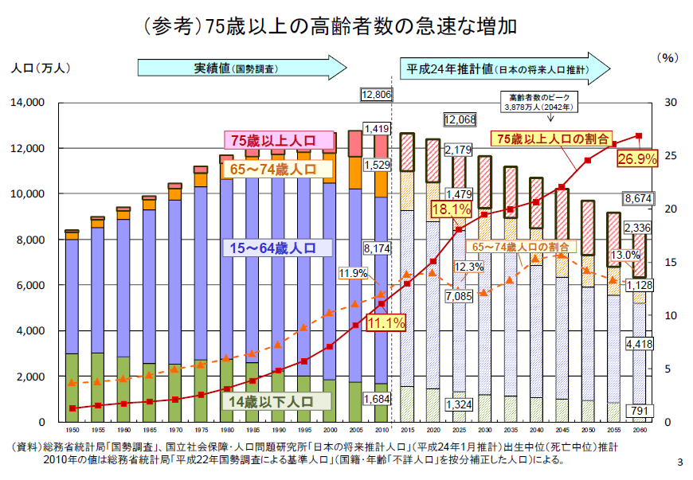
Figure 1: Projection on the population in Japan
Population
(ten thousand)
Census figures
Estimate as of 2012
Max no of elderly
38.78 million (2042)
75 ～
% of persons 75 ～
65～74
15～64
% of persons 65~74
0～14
The Ministry of Internal Affairs and Communications Statistics Bureau as of March 1, 2013

Slide 21
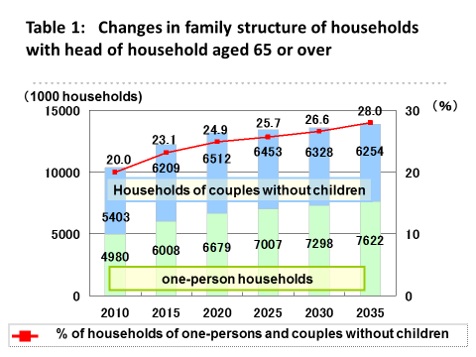

Slide 22
number of the elderly in need of long-term care or support
rapid increase in the number of the elderly in need of long-term care or support is inevitable.
It is expected that by 2025 there will be 7.50 million elderlies in need of long-term care or support assistance, which is 1.7 times the current 4.47 million elderlies in need of long-term care or support.
the long-term care insurance system was established in April 2000.

Slide 23
Financial resources for long-term care insurance
Financial resources for long-term care insurance are split into public funds (50%) and insurance premiums (50%).
The breakdown of public funds is 25% from central government and 12.5% each for prefectures and municipalities.
Premiums are split among the first and second insured persons who will bear 10% or 20 % for each service received. Two years ago, high income elderly who 20 % of service receivers ware needed to pay 20 % for each service received.

Slide 24
Table 3: Changes in the number of first insured persons, accredited persons and service users (a comparison between FY2000 and FY2013)
 | FY2000 | FY2013 | A rate of increase
First insured persons | 2,165 | 3,103 | 1.43
Accredited persons | 218 | 564 | 2.59
Service users | 149 | 471 | 3.16
(ten thousand)

Slide 25
intensive care homes covered by long-term care insurance
The long-term care insurance system in Japan covers 21 at-home medical/nursing care services and three types of long-term care facilities for the elderly.
They are (1)“include intensive care homes ”, (2)“health institutes for long-term care of the elderly” and (3)“long-term health care facilities”.
intensive care homes are known as a special nursing homes for the elderly, provide services to persons who require constant long-term care, but cannot be cared for at home.

Slide 26
Situation of intensive care homes
The most commonly used facilities are the intensive care homes and todays I focused on intensive care homes at my presentation.
There are 8,000 such homes accommodating 50,000 residents, of which nearly 80% have dementia and 70% require intensive nursing care level, and supporting those who cannot live independently at home.
Last year we changed to limit the admission eligibility from five stages of those requiring long-term care to upper 3 stages of those requiring long-term care.
Intensive care home employees include care workers, nurses, residential social workers and et.al as professional staffs.

Slide 27
Table 5: Total expense of long-term care benefits and trends
in premiums for first insured persons
 | total expense (trillion) | Premiums per 1 month for first insured persons (JPY )
FY2000 | 3.6 | 2,911
FY2001 | 4.6 | 2,911
FY2002 | 5.2 | 2,911
FY2003 | 5.7 | 3,293
FY2004 | 6.2 | 3,293
FY2005 | 6.4 | 3,293
FY2006 | 6.4 | 4,090
FY2007 | 6.7 | 4,090
FY2008 | 6.9 | 4,090
FY2009 | 7,4 | 4,160
FY2010 | 7.8 | 4,160
FY2011 | 8.2 | 4,160
FY2012 | 8.9 | 4,972
FY2013 | 9.4 | 4,972
FY2014 | ―― | 4,972
FY2025 | 21.0 | About 8,200

