Slide 1
The Unintended Consequences of Reduced Skilled Nursing Facility Length of Stay
Denise A. Tyler, John McHugh, Renee R. Shield, Ulrika Winblad, Emily A. Gadbois
Presented by Emily A. Gadbois

Slide 2
Acknowledgments
NIA Program Project (Grant #AG-027296)

Slide 3
Background
In the US, patients covered by Medicare often require post-acute care (PAC) after a hospitalization
This care is commonly provided in skilled nursing facilities (SNFs)
In recent years, Medicare policy changes and market-based pressures have resulted in reductions in median PAC length of stay in SNFs
Little research examining associated impacts
Notes:
In the US, patients covered by Medicare, the health insurance program for those over age 65, often require post-acute care after a hospitalization. This care is commonly provided in skilled nursing facilities. Due in part to the emergence of accountable care organizations, which are groups of providers who come together voluntarily to give coordinated care to Medicare patients, and pressure from managed care organizations, including Medicare Advantage, a program offered by commercial insurance companies that serves as a substitute for original Medicare Parts A and B, SNFs have seen a reduction in median LOS in the past few years. However, research has yet to examine associated impacts of these reductions in LOS.

Slide 4
Research Objective
To identify :
  the key challenges that reductions in SNF length of stay (LOS) pose for PAC providers
  the unintended consequences of reduced LOS for PAC providers and patients
  SNF responses to these
Notes:
To this end, the purpose of this research was to identify the key challenges that reductions in SNF length of stay (LOS) pose for post-acute care providers, the unintended consequences of reduced LOS for PAC providers and patients, and SNF responses to these consequences.

Slide 5
Methods
Conducted site visits to 8 markets in the U.S.
In each market: one hospital with a low readmission rate and one with a higher rate, 3 or 4 SNFs that received referrals from those hospitals
Interviewed ~20 staff from the selected organizations in each market, yielding 154 interviews in 16 hospitals and 24 SNFs
Notes:
For this research, we conducted site visits to 8 markets in the U.S.
In each market we selected one hospital with a low readmission rate and one with a higher rate and 3 or 4 SNFs that received referrals from those hospitals. In each of these 8 markets we interviewed about 20 staff from the selected organizations, yielding 154 interviews. Staff respondents included administrators, admissions directors, and directors of nursing in SNFs, and chief medical officers, vice presidents of strategy, hospitalists, and discharge planners in the hospitals.

Slide 6
Methods
Examined median LOS for the 24 SNFs we visited to identify SNFs with LOS reductions between 2012 and 2014, and those without LOS reductions
Data from interviews with staff in SNFs with no LOS reduction were compared and contrasted with data from interviews with staff in SNFs with LOS reductions
Notes:
We also used data on SNF median LOS for 2012-2014 to identify the SNFs with LOS reductions and those with no LOS reductions.
Then data from qualitative interviews with staff in SNFs with no LOS reduction were compared and contrasted with data from interviews with staff in SNFs with LOS reductions.

Slide 7
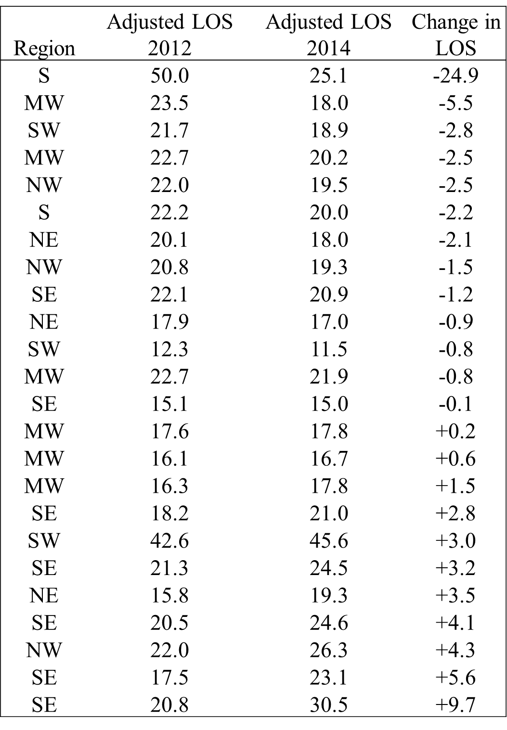
Results: LOS
Notes:
For the 24 SNFs in our sample, results indicate that the median length of stay dropped among 12 of the SNFs. Among the 12 SNFs where risk-adjusted median LOS dropped, the average reduction in LOS was 3.7 days. (median = 2.1 days)

Slide 8
Results: Overview
Among SNFs with LOS reductions:
  No time to help patients find appropriate long term care; had to discharge patients who they felt were unsafe
  Some developed programs to follow-up with patients post-discharge
  Some avoided admitting patients with potential to become long-stay
Among SNFs with no LOS reductions:
  Fear of losing relationships with referring hospitals if they surpass pre-determined length
  Patients becoming unexpectedly responsible for costs
Notes:
Results from the qualitative interviews yielded a number of themes.
Among SNFs with LOS reductions: Respondents reported not having time to help patients that were unable to return to the community to find appropriate long term care; and they had to discharge patients who they felt were unsafe. Some SNFs developed programs to follow-up with patients post-discharge, and some SNFs avoided admitting patients who had the potential to become long-stay.
Among SNFs with no LOS reductions: Respondents reported the fear of losing relationships with referring hospitals if they surpass their pre-determined length. Respondents also reported incidents of patients becoming unexpectedly responsible for costs of part of their stays.
In the next few slides I’ll go over example quotes that illustrate these themes.

Slide 9
Results: SNFs with Reductions in LOS
No time to help patients find appropriate long term care; had to discharge patients who they felt were unsafe
  I came in and I’m like guys, guess what? You gotta discharge these people! ...I’m like get ‘em out guys! Get ‘em out! Get ‘em out! And I feel terrible, it’s awful because you know that they deserve more therapy, they have that benefit. (SNF Administrator)
Notes:
SNF staff reported not having time to help patients unable to return to the community to find appropriate long term care and said they had to discharge patients who they felt were unsafe.
A SNF administrator said: I came in and I’m like guys, guess what? You gotta discharge these people! ...I’m like get ‘em out guys! Get ‘em out! Get ‘em out! And I feel terrible, it’s awful because you know that they deserve more therapy, they have that benefit.

Slide 10
Results: SNFs with Reductions in LOS
  No time to help patients find appropriate long term care; had to discharge patients who they felt were unsafe
    There're times that I feel that there's such a rush. Ya know, people are very sick. And having that sort of expectation put on them, say you're only in a SNF for ten days, to me it's a challenge...A big reward for me is to see the person go home well. But telling an eighty-five year old that I'm sorry, your insurance is only authorizing you to stay for two weeks, then they have to appeal... (SNF Director of Nursing)
Notes:
A SNF Director of Nursing said: There're times that I feel that there's such a rush. Ya know, people are very sick. And having that sort of expectation put on them, say you're only in a SNF for ten days, to me it's a challenge. A big reward for me is to see the person go home well. But telling an eighty-five year old that I'm sorry, your insurance is only authorizing you to stay for two weeks, then they have to appeal...

Slide 11
Results: SNFs with Reductions in LOS
Some developed programs to follow-up with patients post-discharge
  Then, we have the care transition coach that follows them outside when they discharge from us...They call them, talk to them, go visit with them, make sure they’re getting to their doctor’s appointments, if they need help making doctor’s appointments or getting transportation, what are the barriers to taking care of their health at home, to prevent hospitalization. (SNF Admissions Director)
Notes:
Some SNFs overcame these challenges by developing programs to follow-up with patients post-discharge. While these programs served to ease concerns about patients, they also involved non-reimbursable costs for SNFs.
A SNF Admissions Director described such a program: Then, we have the care transition coach that follows them outside when they discharge from us...They call them, talk to them, go visit with them, make sure they’re getting to their doctor’s appointments, if they need help making doctor’s appointments or getting transportation, what are the barriers to taking care of their health at home, to prevent hospitalization.

Slide 12
Results: SNFs with Reductions in LOS
  Some developed programs to follow-up with patients post-discharge
    So our discharge planner does two day, fourteen day, thirty day, and then sixty day follow-ups with that patient to make sure they are taking their medication, to see if they have questions and to see how they're doing. (SNF Administrator)
Notes:
An Administrator at another SNF described a similar program: So our discharge planner does two day, fourteen day, thirty day, and then sixty day follow-ups with that patient to make sure they are taking their medication, to see if they have questions and to see how they're doing.

Slide 13
Results: SNFs with Reductions in LOS
Some avoided admitting patients with potential to become long-stay
  One issue that we all have problems with, and I know we’re not isolated, is when... that patient is going to possibly run out of their SNF days, and not have family support, [and] have a lot of comorbidities. When there’s a placement issue, a lot of times the SNFs are trying to be more creative with the residential facilities on how they can solve that issue. Whereas before, it still was a hospital, acute care problem. (Hospital VP of Care Coordination)
Notes:
Some SNF respondents also noted ways they avoid admitting patients who had the potential to become long-stay.
A VP of Care Coordination at one of the hospitals we visited said: One issue that we all have problems with, and I know we’re not isolated, is when... that patient is going to possibly run out of their SNF days, and not have family support, [and] have a lot of comorbidities. When there’s a placement issue, a lot of times the SNFs are trying to be more creative with the residential facilities on how they can solve that issue. Whereas before, it still was a hospital, acute care problem.

Slide 14
Results: SNFs with Reductions in LOS
Some avoided admitting patients with potential to become long-stay
    So I do the screen and...I have to factor in what kind of insurance does she have, how many benefit days does she have, then I might request an application which requests a financial disclosure so in the event that that person doesn't leave or isn't able to go back to their living environment we have to find a living environment for them and we need to know if they can afford what they really think they want. (SNF Admissions Director)
Notes:
A SNF Admissions Director described the concern of remaining insurance days as part of the SNF’s standard process to screen potential patients: So I do the screen and...I have to factor in what kind of insurance does she have, how many benefit days does she have, then I might request an application which requests a financial disclosure so in the event that that person doesn't leave or isn't able to go back to their living environment we have to find a living environment for them and we need to know if they can afford what they really think they want.

Slide 15
Results: SNFs with No Reductions in LOS
Fear of losing relationships with referring hospitals
  Sometimes it make us, [sighs] not very comfortable, but then you need to work with them, too, you know? It’s a situation that you don’t feel like you want to lose your connection with them and you want to make sure that you reach the goal, the expectation, so all we gotta do is just speed up and do things. (SNF Administrator)
Notes:
In SNFs with no reductions in length of stay, staff reported the fear of losing relationships with referring hospitals if they surpassed their pre-determined length.
A SNF Administrator said: Sometimes it make us, [sighs] not very comfortable, but then you need to work with them, too, you know? It’s a situation that you don’t feel like you want to lose your connection with them and you want to make sure that you reach the goal, the expectation, so all we gotta do is just speed up and do things.

Slide 16
Results: SNFs with No Reductions in LOS
Fear of losing relationships with referring hospitals
    You’re getting reprimanded, for sure, and you know, you don’t like to destroy the relationship that you have with them, because you might end up getting less patients [chuckle], and that’s the thing we’re trying to avoid. There’s no written in stone policy what your consequences would be, but, obviously, you’re gonna get more patients if you follow them. (SNF Admissions Director)
Notes:
A SNF Admissions Director similarly said: You’re getting reprimanded, for sure, and you know, you don’t like to destroy the relationship that you have with them, because you might end up getting less patients [chuckle], and that’s the thing we’re trying to avoid. There’s no written in stone policy what your consequences would be, but, obviously, you’re gonna get more patients if you follow them.

Slide 17
Results: SNFs with No Reductions in LOS
Patients becoming unexpectedly responsible for costs
  For a craniotomy you have between 12 and 17 days... So if you’re gonna hit over 17 they’re gonna say okay, well then discharge them. Well, it’s not safe. Well then, they can’t go home, they just have to pay privately. (SNF Administrator)
Notes:
Some respondents at SNFs with no reductions in length of stay also reported patients becoming unexpectedly responsible for the costs of part of their stay.
A SNF Administrator said: For a craniotomy you have between 12 and 17 days... So if you’re gonna hit over 17 they’re gonna say okay, well then discharge them. Well, it’s not safe. Well then, they can’t go home, they just have to pay privately.

Slide 18
Results: SNFs with No Reductions in LOS
Patients becoming unexpectedly responsible for costs
    If the resident doesn't have co-insurance then they will be responsible for the additional cost which averages out to be about $157 per day... Upon admission we will notify the resident if they don't have co-insurance and they need therapy or they want to stay longer that there may be a payment that they're going to have to be responsible for. (SNF Administrator)
Notes:
Another SNF Administrator said: If the resident doesn't have co-insurance then they will be responsible for the additional cost which averages out to be about $157 per day... Upon admission we will notify the resident if they don't have co-insurance and they need therapy or they want to stay longer that there may be a payment that they're going to have to be responsible for.

Slide 19
Results: SNFs with No Reductions in LOS
Patients becoming unexpectedly responsible for costs
    The resident has the right to appeal and we'll assist with that. Sometimes the appeals do go through and most of the time they don't. (SNF Administrator)
Notes:
Another Administrator referred to the system by which patients may appeal the insurance companies’ decisions to stop paying for care: The resident has the right to appeal and we'll assist with that. Sometimes the appeals do go through and most of the time they don't.

Slide 20
Conclusions
SNFs have seen a reduction in median LOS
The push for shorter SNF LOS has resulted in challenges for SNFs and possible unintended consequences for patients, including increased costs for care and potentially unsafe discharges. Patients may also have difficulty finding facilities willing to accept them if they may eventually need long-term care
Notes:
To conclude, due in part to the emergence of accountable care organizations and bundled payment programs, as well as pressure from managed care organizations, SNFs have seen a reduction in median LOS in the past few years.
We found that the push for shorter SNF LOS has resulted in challenges for SNFs and possible unintended consequences for patients, including increased costs for care and potentially unsafe discharges. Patients may also have difficulty finding facilities willing to accept them if they may eventually need long-term care.

Slide 21
Implications for Policy and Practice
Additional research needed to determine if the challenges and unintended consequences identified by our exploratory research are widespread
Policymakers must ensure patients receive the care they need, are not left responsible for unexpected costs, and are not discharged unsafely or to a location that cannot provide the long-term care they may need
Notes:
Additional research is needed to determine if the challenges and unintended consequences identified by our exploratory research are widespread.
If they are, policies are needed to respond to the issues caused by reduced SNF LOS.
Policymakers should address these issues in ways that ensure patients receive the care they need, are not left responsible for unexpected costs, and are not discharged unsafely or to a location that cannot provide the long-term care they may need.

Slide 22
Thank You
emily_gadbois@brown.edu

