Slide 1
Use of Long-term Care is Increasingly Concentrated in the Last Years of Life
Leena Forma
Postdoctoral researcher
Co-authors: Mari Aaltonen, Jutta Pulkki, Jani Raitanen, Pekka Rissanen, Marja Jylhä

Slide 2
Background
Use of long-term care (LTC) is concentrated in the very old age and in the last years of life.
As the deaths are postponed to increasingly old age, more people will probably use LTC in their last years of life.
The study is a part of the project entitled ‘New Dynamics of Longevity and the Changing Needs for Services’ (COCTEL)

Slide 3
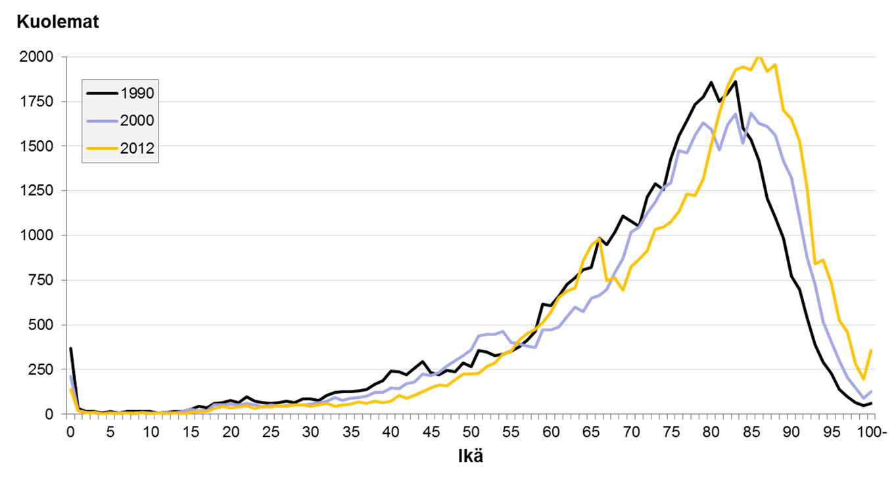
The postponement of death
N of deaths
Age
(Statistics Finland)

Slide 4
Need for LTC?
Disability has found to be
decreasing among people under the age of 80, but
remaining steady or increasing among the oldest individuals.
As the last years of life are lived at a greater age than before
functional and cognitive disability is probably greater,
the phase during which care is needed may be longer.

Slide 5
Aims of the study
To analyse:
the association of use of round-the-clock LTC with approaching death among old people
the change of this association from 2000 to 2011.
Round-the-clock LTC:
Residential homes
Sheltered housing with 24-hour assistance
Primary care hospital if LOS > 90

Slide 6
Data and study design
The data were derived from national registers.
A modification of case-control design:
  Cases (decedents) were those who died between 2000 and 2011 at the age of 70 years or over in Finland.
  Controls (survivors) lived at least two years longer.
  The pairs were individually matched for age, gender and municipality of residence.
  A pair was found for 92% of decedents.

Slide 7
Methods
Use of LTC was studied for the last 730 days for decedents and for the same calendar days for survivors.
Measures:
  any use of LTC
  (number of days in LTC )
Conditional logistic regression analyses were performed to test the association of LTC use with decedent status and calendar year.

Slide 8
Results
The study population consists of 315 458 case-control pairs.
The mean age increased (p<.001)
 | 2000 | 2011
Women | 83.1 | 84.8
Men | 79.6 | 80.9

Slide 9
The OR:s of conditional logistic regression analyses
LTC status: 1=decedent, 0=survivor
LTC use: 1=did use, 0=did not use
 | All (70+) | 70-79 | 80-89 | 90+
 | 6.70 | 9.91 | 6.62 | 4.96
The difference in LTC use between decedents and
survivors was smallest among the oldest,
for use of LTC is high among old survivors, too.

Slide 10
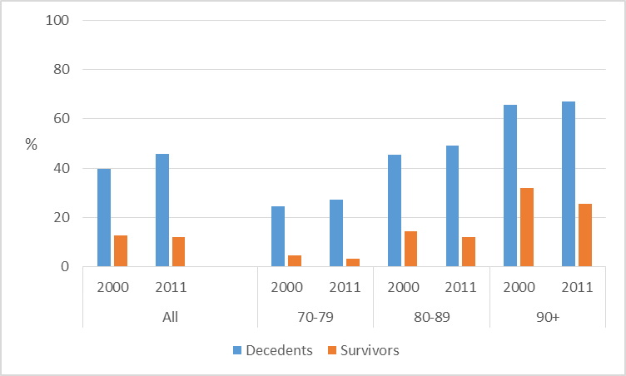
The proportion of LTC users in 2000 and 2011

Slide 11
The difference widened from 2000 to 2011
The interaction term (any use of LTC * year) was positively associated with decedent status.
Use of LTC
  among decedents increased in younger age groups and held steady among the oldest
  decreased among survivors in all age groups.

Slide 12
Policy implications
The association of approaching death with use on LTC became stronger from 2000 to 2011.
→ use of LTC was increasingly concentrated in the last years of life during the twelve-year study period.
Use of LTC is common among the oldest, despite the closeness of death.
As more people live to a very old age, the demand for LTC will increase.

Slide 13
Conclusion
Without strong new evidence of improved functional ability in very old age, the conclusion is clear:
the longer people live and the older they die, the more likely they are to need LTC at the end of their lives.

Slide 14

Thank you!
Leena Forma
Leena.forma@uta.fi
040 190 1604

