Slide 1
4th International Conference on Evidence-based Policy in Long-term Care
London School of Economics, 4-7 September 2016
Automation in the long-term care sector: developing a research agenda
Bernard H. Casey
Personal Social Services Research Unit
London School of Economics
Paul P. Freddolino
School of Social Work
Michigan State University

Slide 2
Automation in the long-term care sector
Outline of presentation
The Baumol curse
Measuring productivity in social care
The “German” and the “Japanese” solutions
Automation in care – “e-health”
Automation in care – robots
Questions – ethics, safety, dehumanisation?

Slide 3
Automation in the long-term care sector
The Baumol curse
AKA “Baumol's cost disease”, “the Baumol effect”
Baumol and Bowen pointed out that the same number of musicians is needed to play a Beethoven string quartet today as was needed in the 19th century; the productivity of classical music performance has not increased. On the other hand, the real wages of musicians (like in all other professions) have increased greatly since the 19th century.
In a range of businesses, such as the car manufacturing sector and the retail sector, workers are continually becoming more productive by technological innovations to their tools and equipment. In contrast, in some labor-intensive sectors that rely heavily on human interaction or activities, such as nursing, education, or the performing arts, there is little or no growth in productivity over time. source: Wikepedia

Slide 4
Automation in the long-term care sector
The Baumol curse (2)
An example – Germany

Slide 5
Automation in the long-term care sector
Measuring productivity in social care
National Accounts
Outputs = “activities undertaken”
“No quality dimension” (2005 Rept.) “little progress” (2016 Rept.)
“Satellite accounts”
Include factor prices, but fails to take account of….
switch from palliative to preventive services, or
from in-kind service to personal budgets
reducing eligibility, or cutting visiting times
increasing real value of the service as society becomes wealthier
No (other) assumptions about labour productivity

Slide 6
Automation in the long-term care sector
The “German” and the “Japanese” solutions
Germany
Heavy reliance on “family” as well as “formal” care
Cost control via low wages
Extensive use of foreign carers via “grey” labour market
150-300K from E. Europe (c1m “regular” employees)
Japan
Reliance on family and low wages, but …
Almost no use of foreign workers
cultural objections / strict language tests
Major users of automation
increasing capital : labour ratio > higher productivity

Slide 7
Automation in the long-term care sector
“E-Health”
Internet-based technologies appear to be changing the long term care equation (Center for Tech and Aging, 2014)
4 categories based on primary location and purpose
1) The Body (physical and mental health status)
  body-worn sensors measuring blood pressure, blood-glucose, sleep patterns, etc. (internet connected for monitoring, advice, prevention)
  pillboxes that track medications (send alarms if not taken)
  mood/emotion monitors (alert carers when indicated)
2) The (Smart) Home (monitoring and maintaining status)
  fall detection systems (though still many false positives)
  environmental sensors (stove, air quality, fire, etc.)
  motion sensors (set to detect deviance and send an alarm)

Slide 8
Automation in the long-term care sector
“E-Health” (2)
4 Categories (2)
3) Community (keeping people connected)
  communication tools (e.g., video conferencing)
  interactive web sites (journaling, sharing photos)
  cognitive and physical gaming sites
  social networking (e.g., Facebook)
  contributing to society through e-volunteering
4) Caregiving (supporting formal and informal carers)
  platforms with best practices and suggestions matched to informal carer needs
  tele-health platforms (facilitate care coordination or manage complex health challenges through remote monitoring)

Slide 9
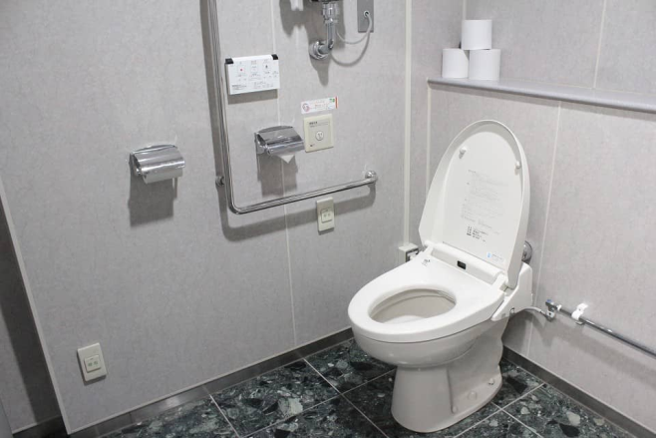
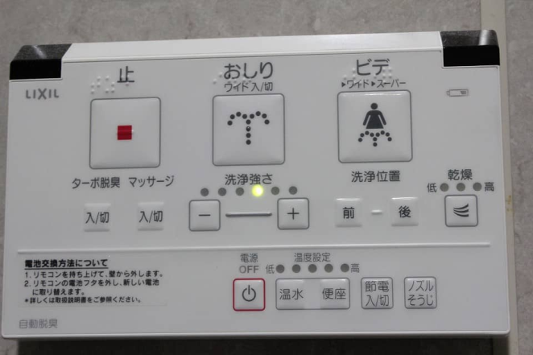
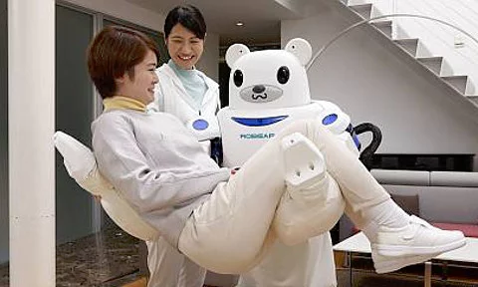
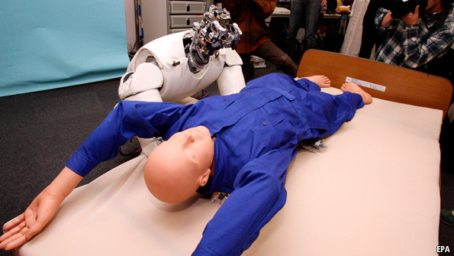
Automation in the long-term care sector
Robots
Some examples
the feeding robot the super-loo
two lifting robots

Slide 10
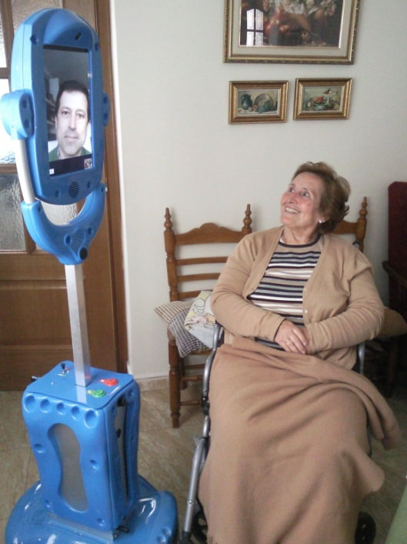
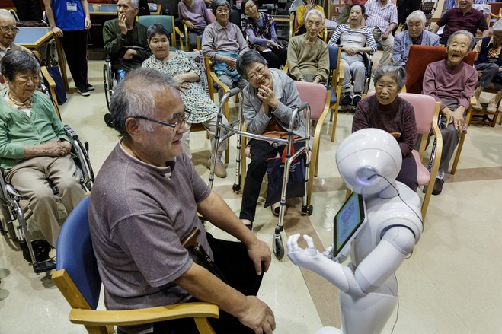
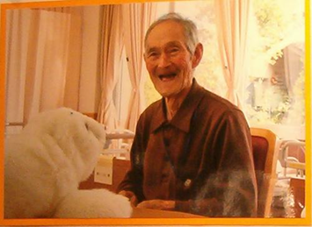
Automation in the long-term care sector
Robots (2)
Some examples (2)
“Japan robot maker to tackle loneliness with R2-D2-like machine” (Financial Times, June 7, 2016)
“Japan may pick robots over immigrants” BBC News: Monday, 17 May 2010 (http://news.bbc.co.uk/1/hi/business/8687196.stm)
The Giraff Pepper Paro (the seal)

Slide 11
Automation in the long-term care sector
Robots (3)
Robots as a curse or a blessing
Roughly 15m jobs in the UK, notably those including administrative, clerical and production tasks, could be at risk of automation, [Bank of England chief Economist] said.
But he added: “To bring that down to planet earth, no one any time soon is, I think, going to choose a robot to cut their hair.” (Financial Times 12/11/15)
Sufficient savings in an open economy will ensure resources in older age and “guest workers” (or robots) will close the caregiving gap. (How Japan and the US can reduce the stress of aging,
C. Goldin, NBER Working Paper 22445)

Slide 12
Automation in the long-term care sector
Questions arising
1) Safety
Are robots too powerful/rigid?
What can be learnt from self-drive cars?
Pepper … uses sensors to monitor what is going on around it before making “independent decisions.”
2) Ethics
“E-health” and data privacy
“E-health” and 24hr monitoring
“E-health”, monitoring and insurance claims
Robots – who has control?
Robots – who can afford them?

Slide 13
Automation in the long-term care sector
Questions arising (2)
3) The human element
Is it “unethical to substitute robot simulacra for genuine human interaction”?
4) Dehumanisation
Does automation dehumanise/objectivise the cared-for?
Can robots be companions/ do they have empathy?
Can Paro reduce anxiety/provide interaction/improve health?
Paro was even listed in the Guinness Book of Records as "the world's most therapeutic robot“
But what makes the seal so practical is not its robotic skills but more its seemingly empathic responses

Slide 14
Automation in the long-term care sector
Questions arising (3)
4) Dehumanisation (2)
….each robot can learn from its interactions with humans and that their experiences will be uploaded to … a database to be shared with other Peppers. This means Peppers can evolve as a collective intelligence.
How much dignity is there in having your bottom wiped?
5) Lack of evidence base
re cost effectiveness
re acceptability

