Slide 1
The German Long Term Care Insurance Market: The Impact of Public Subsidies
Pamela Nadash, PhD, BPhil
Associate Professor, Gerontology, Fellow, Gerontology Institute
University of Massachusetts, Boston
Alison Evans Cuellar, Ph.D.
Associate Professor, Health Administration and Policy
George Mason University, Fairfax, Virginia
,
Presentation at the International Conference on
Evidenced-Based Long Term Care Policy, London, England
September 4, 2016

Slide 2
Would like to acknowledge the contributions of Matthias von Schwanenflugel and Sabrina Link, Gen Re

Slide 3
Overview of the German LTCI Program
Mandatory coverage for nearly all Germans
  Most in the public scheme (~90%)
  Remainder obtain mandatory coverage from private insurers
The benefit is flat-rate
Value of benefit decreased over time, due to inflation – estimated to cover 40-50% of costs
Concerns about long-term financial sustainability, due to population aging
Major reforms began in 2008

Slide 4
German LTCI Reforms
Table 1: Selected Program Changes -- Germany’s LTCI Program
 | Year | Change
Premiums* | 1995 | Established at 1.7% of income
 | 2002 | Retired people contribute full premium
 | 2005 | Added 0.25% for childless adults
 | 2008 | Increase to 1.95%
 | 2015 | Increase to 2.35%
 | 2017 | Increase to 2.55%
Benefit adjustments | 2008, 2010, 2012 | Incremental increases to benefit levels
 | 2014 | Benefit index-linked
Caregiver Benefits | 2008 | Public pension contributions
 | 2008 | Unemployment insurance contributions
 | 2008 | Subsidies for health insurance and LTCI
 | 2016 | Extension of pension benefit to more caregivers
Benefits for cognitively impaired | 2002 | Annual payment (€460) for cognitively impaired
 | 2008 | Monthly supplement to benefit, tiered based on basic benefit
 | 2017 | New assessment tool incorporating need for supervision
Counselling | 2008 | Introduction of community-based care support centers
 | 2009 | Legal right to counselling consultation
Source: Authors analysis

Slide 5
Another reform: the Pflege-Bahr
Subsidy for the purchase of private supplemental LTCI -- €5 per month
No underwriting
Premiums can vary by age but not by gender
Cash benefits, which must meet certain minimums:
  for disability at level 1, the policy must cover at least 20 percent of the statutory amount;
  at level 2 it must cover at least 30%;
  and at level 3, benefits must be at least 600 Euros.
Eligibility (not service use) triggers payment, and is established using statutory disability criteria
Claimants must have held policies for 5 years, although insurers may opt to allow shorter eligibility periods.
Benefits may not exceed 100% of statutory benefits when contract is signed, but may include inflation riders

Slide 6
Aim was to boost the existing market for supplemental LTCI
Products have been available since 1984
Two main types:
  Offered by health insurers – tied to the statutory benefit, tend to be cheaper
  Offered by life insurers – annuities with fixed premiums, broader coverage for dementia, surrender value
  Majority sold are health insurance: 2.3 million vs 140,000
Most policies pay cash: In 2014 2.3 million policies were for cash benefits and 370,000 for services coverage
On average, 12% growth in sales annually from 1995-2012

Slide 7
Supplemental LTCI Policies, 1995-2015
Source: Verband der Privaten Krankenversicherung, Zahlenbericht” various years.

Slide 8
Year on Year Percent Changes in Supplemental Policy Sales Since 2013
Source: Verband der Privaten Krankenversicherung, Zahlenbericht” various years.

Slide 9
Sales patterns confound expectations
The lack of underwriting in the subsidized market meant that, for good risks, policies in unsubsidized market would be cheaper
Consumers are advised that unsubsidized products are likely a better deal if you’re young and healthy
Observers expected risk segmentation and eventual cost increases in the subsidized product
Over the short term, this pattern is not apparent
Sales of unsubsidized products have dropped
Note also that the growth in sales of subsidized products has slowed considerably

Slide 10
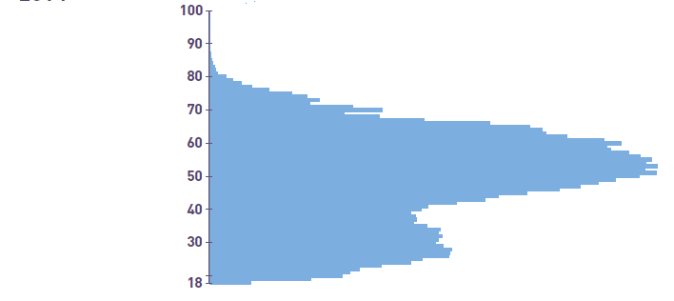
The age distribution of subsidized product sales looks healthy
Source: Verband der Privaten Krankenversicherung. 2015. “Zahlenbericht”

Slide 11
What about benefit adequacy?
Illustration of Premiums and Benefits Under Supplemental Subsidized LTCI in 2014 – Nursing Home Level of Care
 |  | Assumptions | Euros
Monthly Premiums | Public LTCI | 1.95% up to 83.02 pm | 83
 | Subsidized Supplemental LTCI | 260 annual^{i} | 22
 | Total |  | 105
Monthly Benefits | Public LTCI | Level III^{ii} | 1550
 | Subsidized Supplemental LTCI |  | 600^{iii}
 | Total |  | 2150
Monetary Impact | Average cost of NH |  | 3270^{iv}
 | Out of Pocket Cost, with Supplemental Insurance | Monthly NH cost minus Total Benefits | 1120
 | Average Monthly Income, 76+ | €19,289 annual^{v} | 1607
 | Disposable Income, No Supplemental Insurance | Income minus OOP costs, without supplemental benefit | (113)
 | Disposable Income, Supplemental Insurance | Income minus OOP costs | 487
Source: ^{i}https://www.pkv.de/service/zahlen-und-fakten/archiv-pkv-zahlenbericht/zahlenbericht-2014.pdf ^{ii}Benefit in 2014. “Hardship” cases receive €1915. ^{iii}This is the minimum benefit allowable under legislation; although there are no data on average benefits offered, this appears to be the most common coverage option https://www.1averbraucherportal.de/versicherung/pflegeversicherung/pflege-bahr. ^{iv}Götze & Rothgang, 2015. ^{v}OECD data from http://stats.oecd.org/index.aspx?queryid=66599

Slide 12
In conclusion
Subsidizing the purchase of supplemental insurance has boosted sales of subsidized products, but has not had much of an impact on the market overall
Sales growth in subsidized products has slowed
Rather than benefitting the unsubsidized market, the subsidy appears to have hurt it
Need to understand
  Whether the subsidies are attracting buyers who would be screened out due to underwriting or not
  Whether these policyholders lapse at different rates
  Why sales of unsubsidized products have dropped
  How these trends play out over the longer term
Is this a good use of public monies?

