Slide 1
Can experiments built a bridge between science, policy and practice?
Satu Karppanen
Ministerial adviser
Department for Social and Health Services,
Ministry of Social Affairs and Health

Slide 2
Overview
Some details about Finland
Healthcare and social welfare reform package in Finland
Facts about Finnish Social Welfare and Health Care for the older population
Government key project

Slide 3
Finland
Population: 5,5 millions, 65 + years of age 20%, 75+ years of age 8,6%, life expectancy: men 77,8 and, women 83,8 years
Member of EU since 1995
Republic: president + parliament
Monetary unit: Euro

Slide 4
Governance
In 2015 there were about 300 relatively independent municipalities
Each of the communities are obliged, by legislation, to ensure Health- and social care for their inhabitans –including LTC = high degree of decentralization

Slide 5
Healthcare and social welfare reform package in Finland

Slide 6
Solution for arranging the services
18 autonomous regions (counties) will be established from the beginning of the year 2019.
Counties will have responsibility for healthcare and social welfare services
Also some other duties will be under the mandate of the counties
Specialised operations and emergency duties will be centralised
Counties will be managed by elected councils

Slide 7
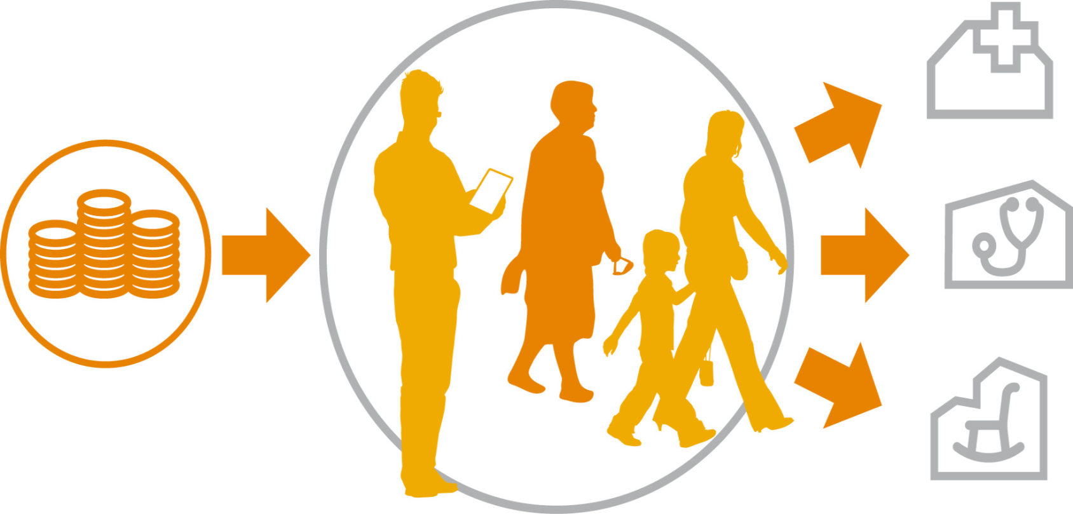
More freedom of choice in healthcare and social services
Each county approves the service providers and sets quality criteria.
The adoption procedure and criteria are under preparation.
Opportunities will be ensured for small and medium-sized enterprises to offer their services.
The counties give information to help residents in their decision making.
Within the range of services covered by the freedom of choice, customers choose either a public, private or third sector service provider.
The counties grant the same pecuniary compensation to public and private service providers.

Slide 8
Why is the reform needed?
The growing need for services among the aging population, the changing range of illnesses and wider possibilities for treatment along with greater expectations from the population create pressure for mounting costs
Slow economic growth and a high total tax rate by international standards are an impetus for finding new ways to curb rising costs.
Inequalities among different areas and groups

Slide 9
Facts about Finnish Social Welfare and Health Care for the older population
The Finnish municipal model for service provision

Slide 10
Policy trends and legislation at the services for the older persons
The Act on Supporting the Functional Capacity of the Ageing Population and on Social and Health Care Services for elderly people (980/2012) came into force in 1st July 2013 in Finland.
Quality guidelines for older persons care (2000, 2008, 2013) have been used as a national tools for information guidance
Since 1990’s policy focus has been on home care and deinstitutionalization

Slide 11
Structure of the services
Service form/75+ population (%) | 2010 | 2011 | 2012 | 2013 | 2014 | 2017 target
Living at their own home | 89,5 | 89,5 | 90,0 | 90,3 | 90,5
Regular home care | 11,8 | 12,2 | 11,9 | 11,9 | 11,8 | 13
Support for informal care | 4,2 | 4,4 | 4,5 | 4,6 | 4,5 | 5,5
Service housing with 24-hour assistance | 5,6 | 5,9 | 6,1 | 6,5 | 6,7 | 7
Institutional care | 4,7 | 4,4 | 3,8 | 3,1 | 2,6 | 2

Slide 12
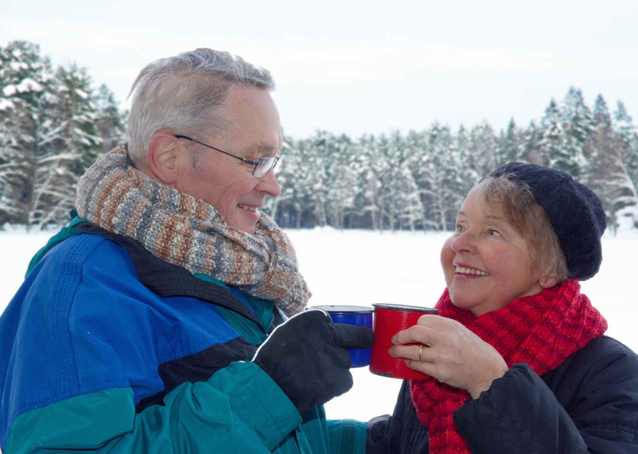
government Key Project, 2016-2018: Home care for older people will be developed and informal care enhanced in all age groups

Slide 13
Government has 26 key projects of which five are in Ministry of Social Affairs and Health
Increasing health and wellbeing
1. Client centered services
5. Way to work life to those partly fir for work
4. Program for renewal of home care services for older people and enhancing informal care for all aged carers
2. Promotion of health and wellbeing
3. Program for renewal of services to children and families
130
m. euros

Slide 14
Actions needed because
Services for older people are scattered, structure has not evolved fast enough or according to national aims, dispersion of best practices has been slow, regional differences are vast
Similar patterns have been found concerning informal care

Slide 15
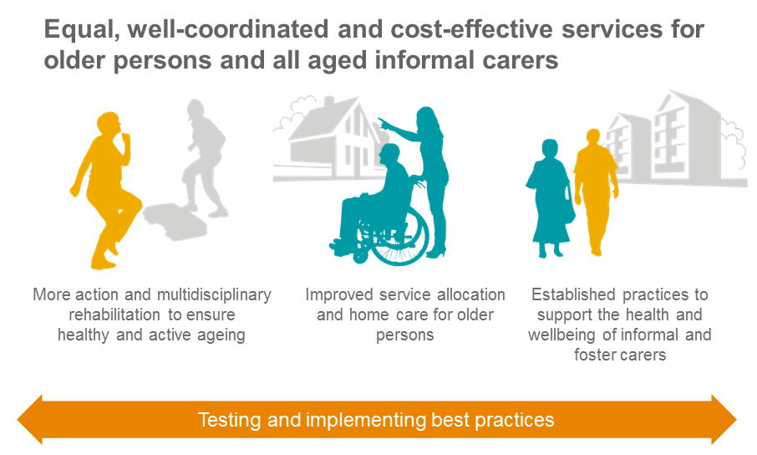

Slide 16
Testing and implementing best practices
Criteria for grant applications (30 million euros):
Relevance: in area of interest based on
theoretical and evidence based modeling
Size: big areas, counties with all or almost all of their municipalities
Participants: Municipalities, public and private providers, organizations, companies etc.
Application period: 10th May to 31st August 2016, pilots / experiments start in October

Slide 17
Tasks of the key project
State grant: Agent of change to all counties (18 + 1)
Agent of change: to help to provide an area-based plan of services and guidance on its implementation
Action 1:
Developing home care
Creating and testing a regional centre for service guidance and allocation
A new concept of home care on county level
Action 2:
Enhancing informal carers in all age groups
Evidence based model of co-operation of older persons with memory disorders
Evidence based model of supporting informal carers of mental health and substance abuse rehabilitees
Combining housing and services
Informal and foster care centres will be established
Model of informal care of children with disabilities
Pilots/Experiments
in one or more counties
Pilots/Experiments
in one or more counties
Action 3: Evaluation

Slide 18
Follow-up
Statistics, registers, research
Follow-up of the Older Care Act (2013, 2014) continues 2016, 2018
In each pilot/experiment, follow-up information will be collected
Whole project - a review at the end
Council of scientific advisors

Slide 19
Thank you!

Slide 20
Contact us
Director Päivi Voutilainen
Project Manager Anja Noro
Ministerial Adviser Satu Karppanen
Ministerial Adviser Anne-Mari Raassina
Secretary Tarja Slant-Storti
ikioma.karkihanke@stm.fi
#IKIOMAT

